Slide 1
Introduction to OpenGL ES

Slide 2

What is ?
Open Graphics Library
A cross-language, multi-platform API for rendering 2D and 3D computer graphics.
The API is used to interact with a Graphics Processing Unit (GPU)
Achieve hardware-accelerated rendering.
OpenGL was developed by Silicon Graphics Inc.
For more information: http://en.wikipedia.org/wiki/OpenGL

Slide 3
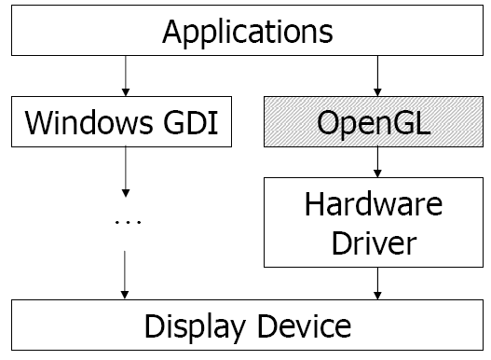
What is ?
An application interface to access GPU.

Slide 4
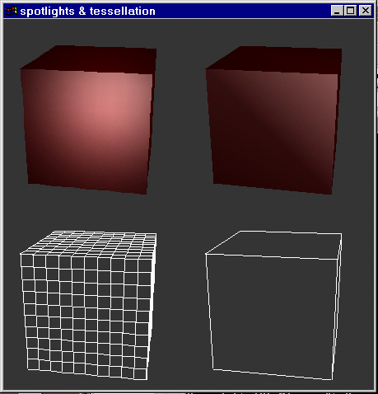
What can do??
Draw points, lines, and polygons.
OpenGL.org

Slide 5
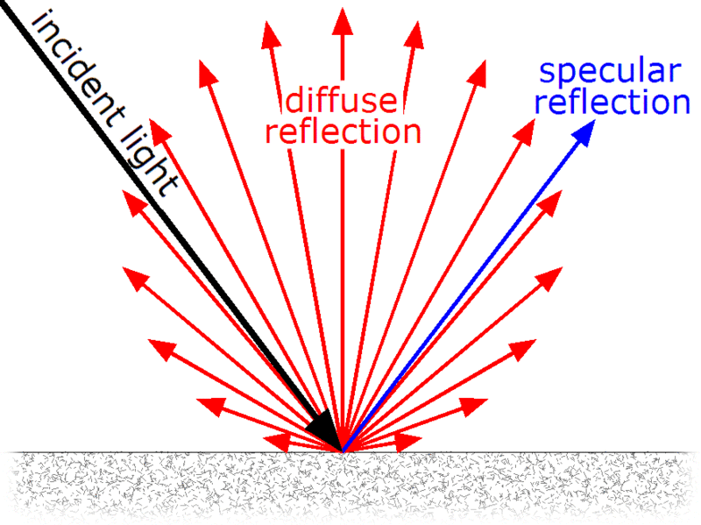
Lambertian reflection
Diffuse and specular reflection from a glossy surface, e.g. polished marble.

Slide 6
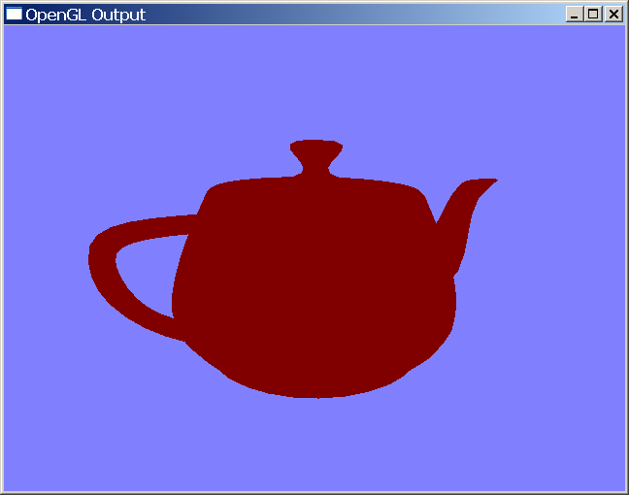
What can do?
Add lighting effect in the scene.
Ambient light: gross approximation of light, which produces constant illumination on all surface.
OpenGL.org

Slide 7

What can do?
Add lighting effect in the scene.
Diffuse light: reflection of light from a surface that is reflected at many angles rather than at just one angle.
OpenGL.org

Slide 8
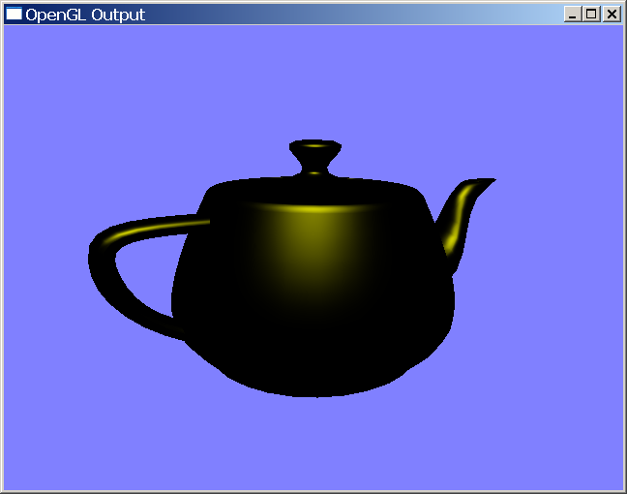
What can do?
Add lighting effect in the scene.
Specular light: mirror-like reflection of light from a surface with a single outgoing direction.
OpenGL.org

Slide 9
What can do??
With different lighting parameters for an object, the object have different appearances.
No Ambient
Gray Ambient
Blue Ambient
Diffuse Only
Specular
Higher Shininess
Emission
CG course in NCTU

Slide 10
What can do?
Map textures to the surface of an object.
CG course in NCTU

Slide 11
function pipeline
Before OpenGL 2.0
Triangles/Lines/Points
API
Primitive
Processing
Transform
and
Lighting
Primitive
Assembly
Rasterizer
Vertices
Vertex
Buffer
Objects
Texture
Environment
Colour
Sum
Fog
Alpha
Test
Depth
Stencil
Colour
Buffer
Blend
Dither
Frame
Buffer

Slide 12
Primitive Assembly
Primitives are broken down into individual points, lines, and triangles.
For example, triangle strip to be rendered. Then the triangle strip is converted into triangles.

Slide 13
Fixed function pipeline
Transformation & lighting
Model, view, projection transformation
Lighting computation
Texture Environment
Texture coordinate computation
Colour Sum
Fog
Alpha Test
For the transparent object in the scene

Slide 14
function pipeline
ES2.0 Programming Pipeline
Triangles/Lines/Points
API
Primitive
Processing
Vertex
Shader
Primitive
Assembly
Rasterizer
Vertices
Vertex
Buffer
Objects
Fragment
Shader
Depth
Stencil
Colour
Buffer
Blend
Dither
Frame
Buffer
OpenGL.org

Slide 15
Programmable function pipeline
Vertex Shader
Handle Transformation & lighting part in fixed pipeline.
Fragment Shader
Handle the following parts in fixed pipeline
Texture Environment
Colour Sum
Fog
Alpha Test

Slide 16
Additional Information
OpenGL (Open Graphics Library)
For more information:
http://www.opengl.org/
Book: Donald D. Hearn, M. Pauline Baker, “Computer Graphics with OpenGL”, 3/E, Prentice Hall, 2004

Slide 17

What is ??
OpenGL ES ( OpenGL for Embedded System )
A subset of the OpenGL application programming interface (API)
Designed for embedded systems
mobile phones, Personal Digital Assistant(PDAs), and video game consoles.
Lightweight interface
Differences from OpenGL
Programmers need to compute projection matrix & transformation matrix.
No glBegin() and glEnd(). No GL_QUADS and GL_POLYGONS.
Vertex information are attributes.
For more information: http://en.wikipedia.org/wiki/OpenGL_ES

Slide 18
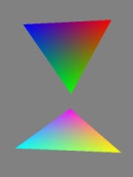
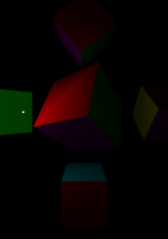
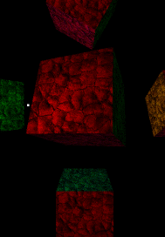
What can do ?
OpenGL ES
Draw points, lines, triangles.
Render meshes with textures and lighting effects, etc.
Draw polygons
Put a light in the scene
Texturing the objects

Slide 19
function pipeline
In OpenGL ES 1.0/1.1
Use fixed function pipeline
In OpenGL ES 2.0
Use programmable function pipeline

Slide 20
Additional Information
OpenGL ES
For more information:
http://www.khronos.org/opengles/
Android OpenGL ES lessons http://developer.android.com/training/graphics/opengl/index.html
Learn OpenGL ES http://www.learnopengles.com/

